Slide 1
JDS-1
Java Design Studio - 1
Instructor
Ryan Liu
dio.ryanliu@Hotmail.com

Slide 2
Introduction
Self-introduction
Experience
Homework ☺
https://www.hackerrank.com/domains/java/java-introduction
Notes:
Self-introduction:
My name is Ryan Liu, currently a third year computer engineering student at UBC
I’ve worked at a few companies during my co-op program, so I’m fairly experienced
Ask Students to do a quick introduction and ask them about their experience
There will be weekly homework, and it’ll start off easy but it will definitely ramp up to hard so students should definitely work hard outside of class

Slide 3
Projects
Library Management System (Possible GUI + Database)
Simple Game (GUI)
Calculator (GUI + Support for Derivatives / Integrals)
Quiz Maker (Meant to be used for School)
Custom Project
Notes:
The first few are sample projects, meaning they are projects I’ve come up with
If you don’t want to pursue these projects, you are welcome to come up with your own idea. If you do decide to go with this, discuss it with me as I need to approve of its difficulty levels beforehand
We need to decide what projects everyone is doing by the end of the first hour

Slide 4
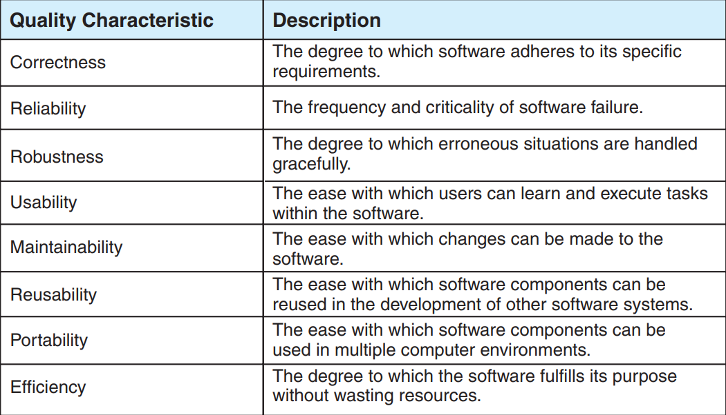
Sofware Structure
What are Data Structures and Algorithms?
Why do we use them?
“Software Quality”
Notes:
What are Data Structures and Algorithms? Ask Students for examples
Why do we use them?
Just because something works doesn’t mean it “works”.

Slide 5
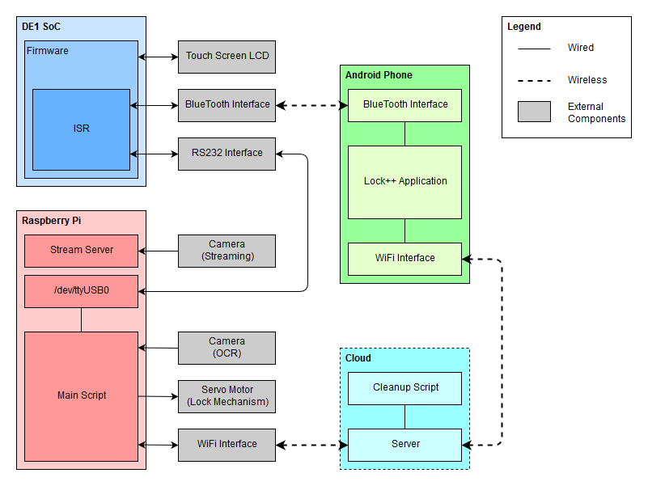
Design Example
Notes:
Continuation of last slide and our choices
Why did we make these choices?

Slide 6
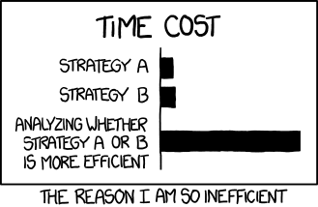
Sofware Architecture
What is Software Architecture?
Why do we use it?
Analysis vs Design
Notes:
Software Architecture defines:
The components of the software system
How the components interact
How control is managed between the component
Why:
Decomposes complex system into not so complex components
Splitting of work
Lays down proper groundwork
Analysis:
Asks “what is the problem?”
Is needed to understand what is required
Design:
Investigates “how to build a solution”
Focuses on building technical solutions
When someone designs anything, they first must ask what does this solve?

Slide 7
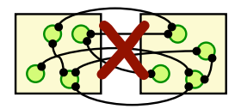
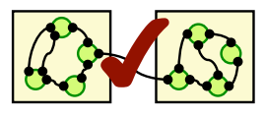
Coupling
Min connection b/w modules
Max connection w/in modules
Cleans up overall system

Slide 8
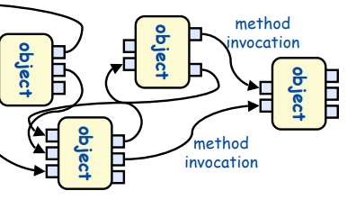
Object Oriented
Hides data under “Objects”
Decomposes problems into individual problems
Objects must know identity to interact
Notes:
Abstract Data types (things you should be familiar with)

Slide 9
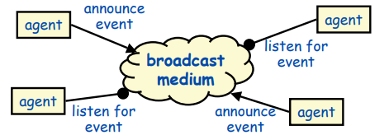
Event Based
Broadcaster and listeners are separate
Reusable and easy to add new broadcasters
Lack of control over ordering
Notes:
Example:
GUI, Debugging Systems, etc

Slide 10
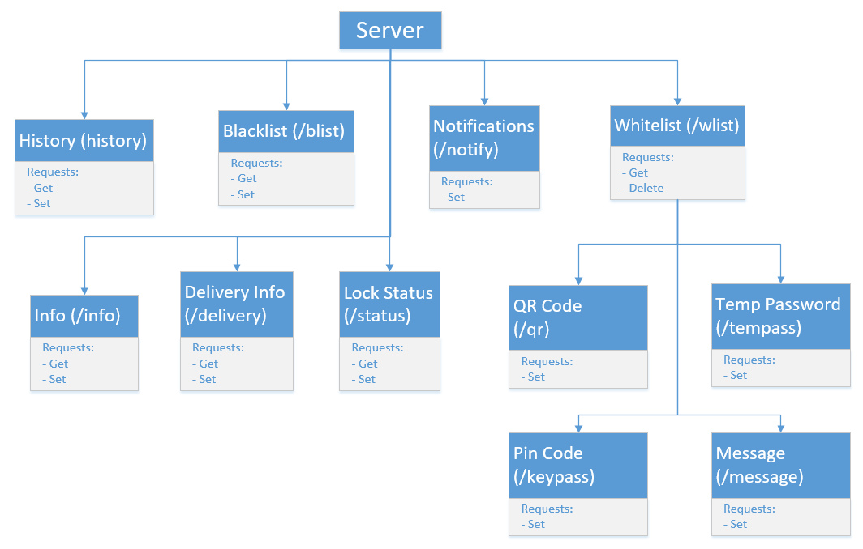
Architecture Example - 1
Notes:
Continuation of last slide and our choices
Why did we make these choices?

Slide 11
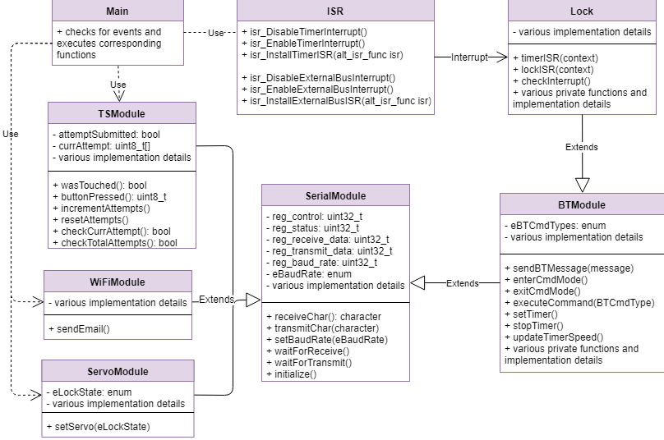
Architecture Example - 1
Notes:
Continuation of last slide and our choices
Why did we make these choices?

